Slide 1
ML FINAL Music Analysis
Henok Alemu, Jorge Vigil, Chris Cheung
Anish Vallabhaneni, Srikar Viswanatha

Slide 2
CONTENTS
Introduction
Problem Definition
Pre-Processing
Models
Results
Discussion

Slide 3
Problem Definition
Music is ubiquitous in everyday life​
Hard to find new music that fits your taste and mood at a given time​
Finding music and creating organized personal playlists is time consuming​
Solving these problems will lead to a much more seamless and enjoyable experience listening to music​

Slide 4
Preprocessing

Slide 5





Step 1
Step 2
Step 3
Step 4
Step 5
Feature Selection
Data creation
Mean of Features
Data Cleaning
Principle Component Analysis (PCA)

Slide 6
Models

Slide 7
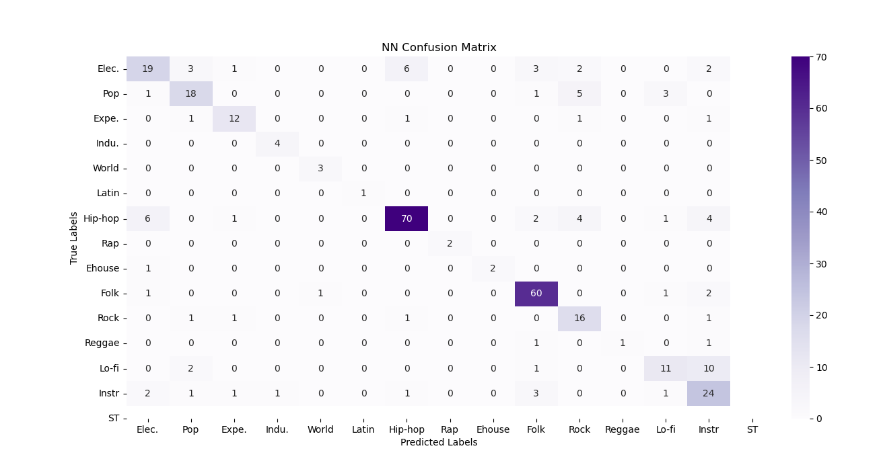
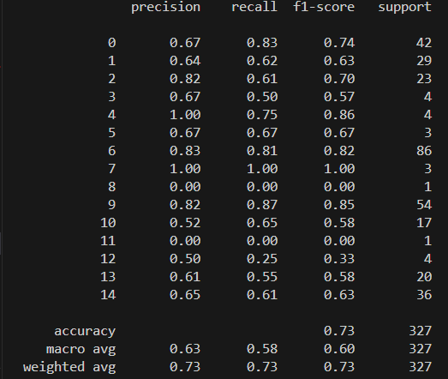
Neural Networks

Slide 8
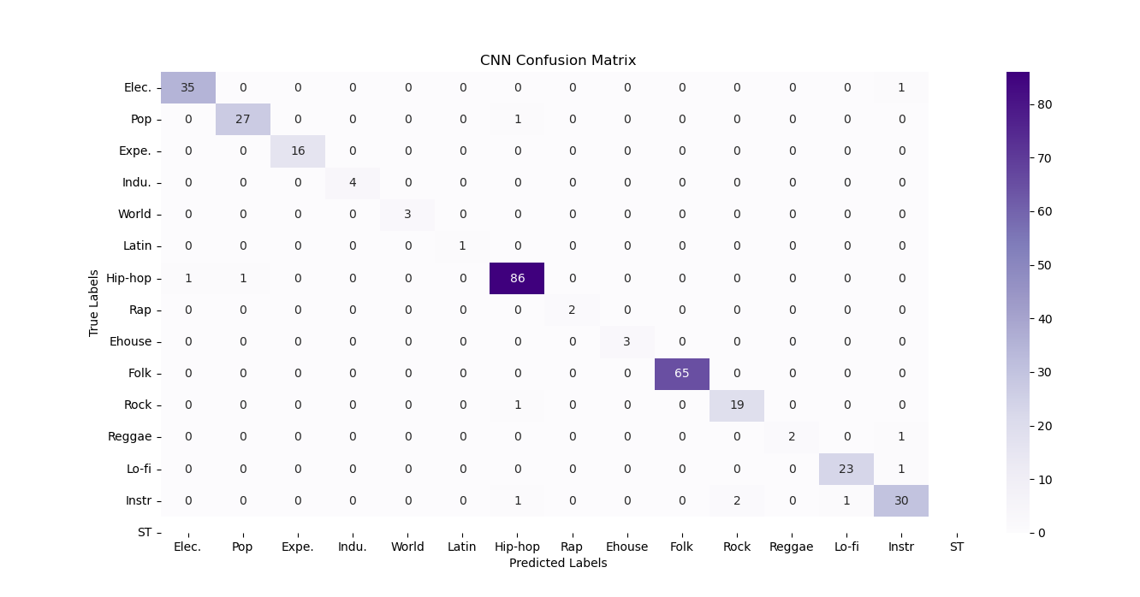
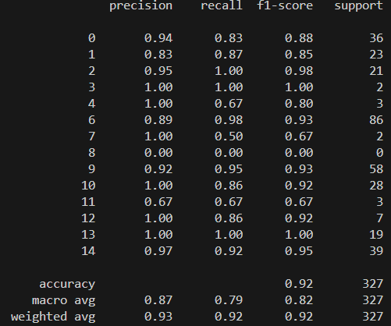
Convolutional Neural Networks

Slide 9
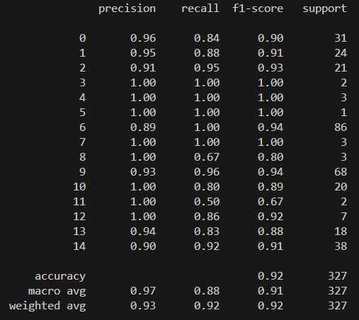
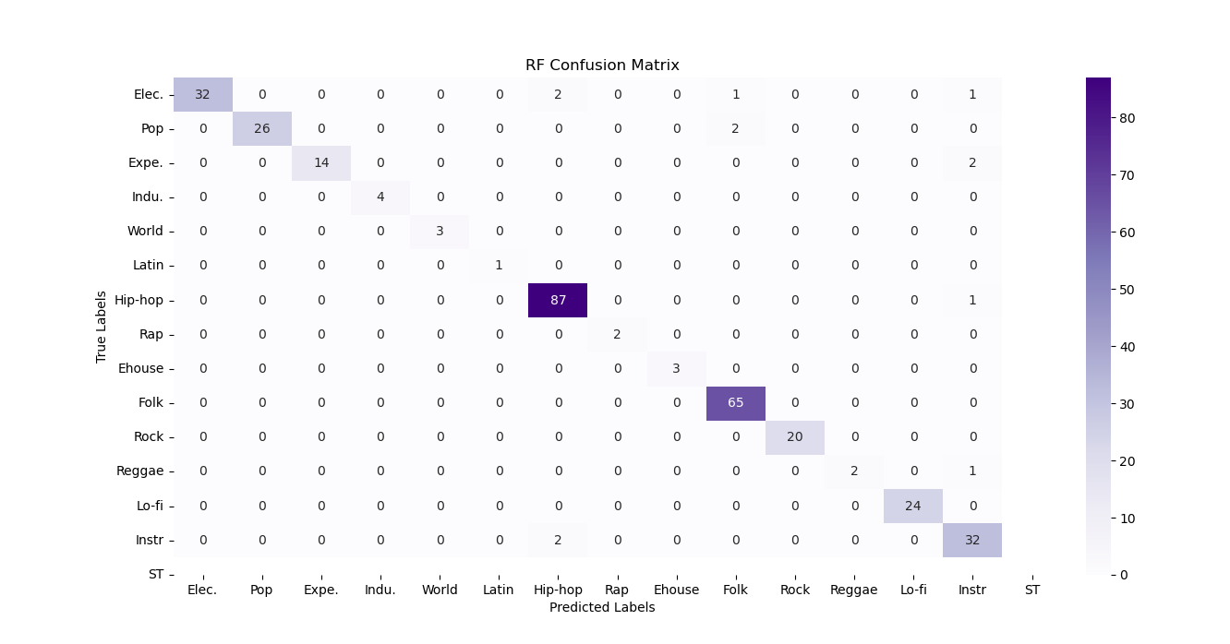
Random Forests

Slide 10
Results

Slide 11
Metrics

Slide 12
Comparisons
NN
CNN
RF
Hyperparameters and structure to configure
Overfits training data
Lots of hyperparameters and structure to configure
Can be tuned to fit the data very precisely
Quick and easy to implement
Naturally well suited to audio data

Slide 13
What next?
Experiment with more models
SVM
Success with classification
The kernel trick allows it to find hyperplanes based on the relationships between audio features.
Fine tune the structure and hyperparameters of the CNN and random forest models.

Slide 14

THANK YOU!

